Slide 1
JEPPIAAR TRANSPORT
PROJECT MEMBERS :
Ajay M
Akash M
Akshay PK
PROJECT GUIDE:
Mr Gladwin

Slide 2
ABSTRACT
The issue of continuously changing bus routes have made so many students be in different minds as to whether choose this route or another one.
This application solves that problem and goes on to describe as to how a student can choose a bus route given a number of routes or even search for and look for a particular location where he desires to go to.
This application has a simple login and register screen that allows the student to enter his college credentials along with his personal details to register himself to this application.
Once registered the user is forwarded to the login screen where he just needs to enter his college register number and password to go on to view all the bus routes available.

Slide 3
ABSTRACT
The bus routes are totally around 42 in number and is constantly changing every day.
Hence we tend to deploy this application over a server based mechanism where the routes are entered onto the server any time of the day and once the student logs in to the application can see all the new refreshed routes for that day. Therefore the requirements are simple.
A front end described in JSP and HTML code which gives the ADMIN access to changing the routes which is constantly in sync with the ANDROID Application so that once the routes are changed by the ADMIN it gets reflected in the mobile application.
The routes are described along with GOOGLE MAPS so that the student gets real time look at where the bus would be going for that day.

Slide 4
ABSTRACT
Along with the routes we tend to describe the exact roads on which the bus would be travelling on. The start and end points can also change accordingly to the college timings.
If this is deployed then the students will have no problem in going on time to their buses as well as the buses leaving the campus on time.
Every student must have this app on his phone or this app can be deployed on many Ipads or Tv's placed on campus for the students convenience.
This app can also be displayed on Tv's placed on every floor fifteen minutes before the students leave to their respective buses.
From this project , we wish to build a student friendly application that helps them in many ways other from what is described in this abstract.

Slide 5
OBJECTIVE
Objective of the project is to develop a new web application for maintaining a good transportation the college campus.
The proposed project is a web application to maintain a good transportation in the campus.
The main objective is to make the daily routes easily accessible to all students and staffs in the campus.

Slide 6
MOTIVATION
As per getting the feed backs that are obtained from the students ,the current scenario of the college transportation is evaluated and we came to the idea of developing a web application to manage a good transportation in our college.
We are developing this application to give the students and faculties to experience a new way of representation of daily routes in the college.
The main purpose is to minimize the consumption of papers on a daily basis.

Slide 7
PROBLEM FORMULATION
Assessing the problem :
Multiple changes in bus route.
Divided the problem based upon three entities :
Departure based on the different timings.
Departure based on regular timings.
Departure based on number of students.
We will be addressing all these three different problem domains and provide a solution to the ADMIN to enter details based on those problem domains and also provide a platform to the students to view all the routes for that particular day.

Slide 8
PROPOSED SYSTEM
THE PROPOSED SYSTEM :
We will be having two different platforms : ADMIN , USER .
We will be having multiple web pages for the ADMIN to enter details into the form and perform operations such as SAVE,UPDATE,DELETE a route.
We will be having a USER platform where the ROUTES for that particular day will be viewed once the ADMIN has performed the necessary changes.
MYSQL – CORE JAVA – J2EE
Following the MVC Architecture. (Model , View , Controller).

Slide 9
REQUIRED SOFTWARE / HARDWARE
Minimum System Requirements to run the software :
OS : Windows 7 or higher versions.
RAM : 2GB
Browser : Chrome v38 or higher.
HDD : 50Gb
Maximum System Requirements to run the software :
OS : Windows 7 or higher versions.
RAM : 4GB
Browser : Chrome v38 or higher.
HDD : 50Gb

Slide 10
BLOCK DIAGRAM
WEB PAGES – INSERT , UPDATE , DELETE ROUTES.
CONTROLLER –
TALKS TO WEB PAGES AND TO CORE MODULES.
DATA ACCESS OBJECT (DAO)
CORE MODULES – MODEL , DAO , VALIDATOR , SERVICE , USER DEFINED EXCEPTIONS.
DATABASE

Slide 11
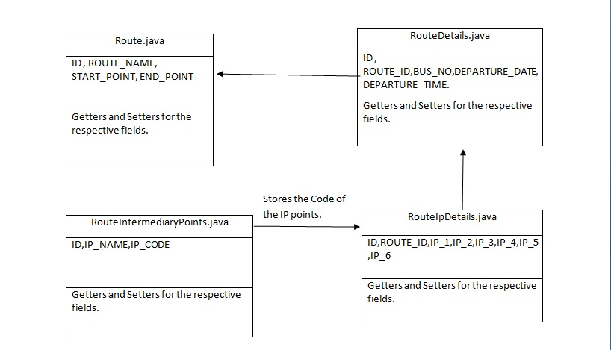
DATA OBJECT MODEL

Slide 12
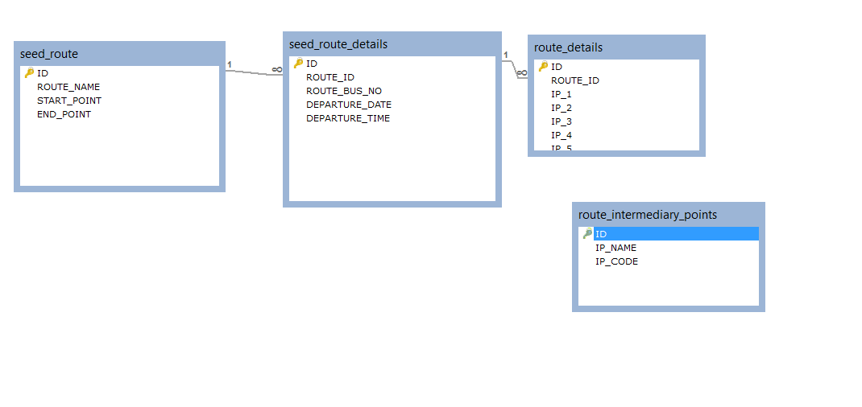
DATABASE DESIGN MODEL

Slide 13
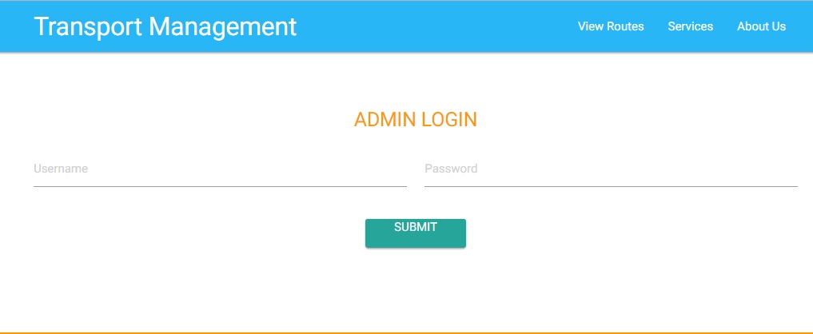
SCREENSHORT 1
LOGIN PAGE

Slide 14
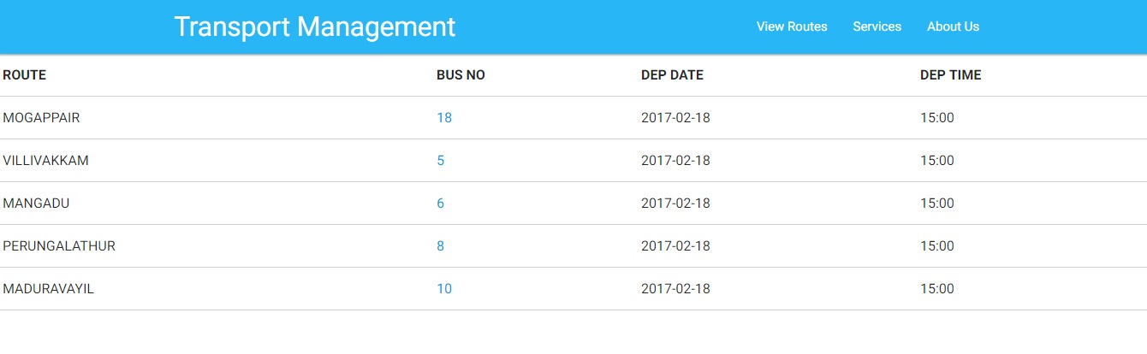
SCREENSHORT 2
View routes for the particular day for the students :

Slide 15
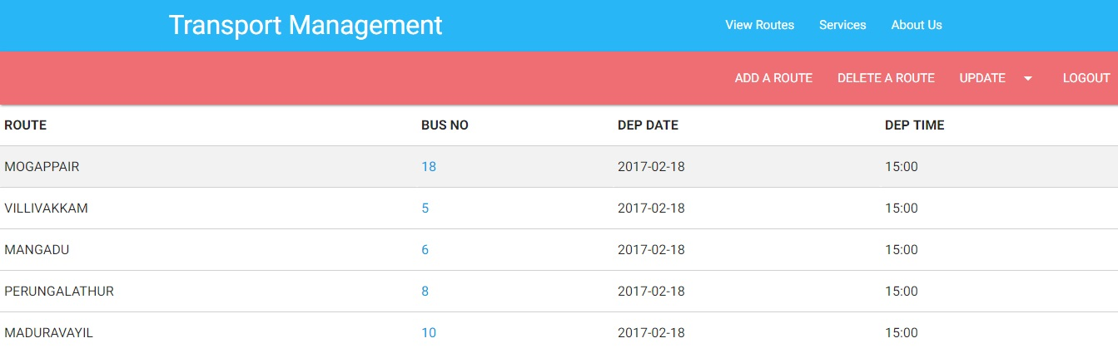
SCREENSHORT 3
View routes for the particular day for the admin and edit :

Slide 16
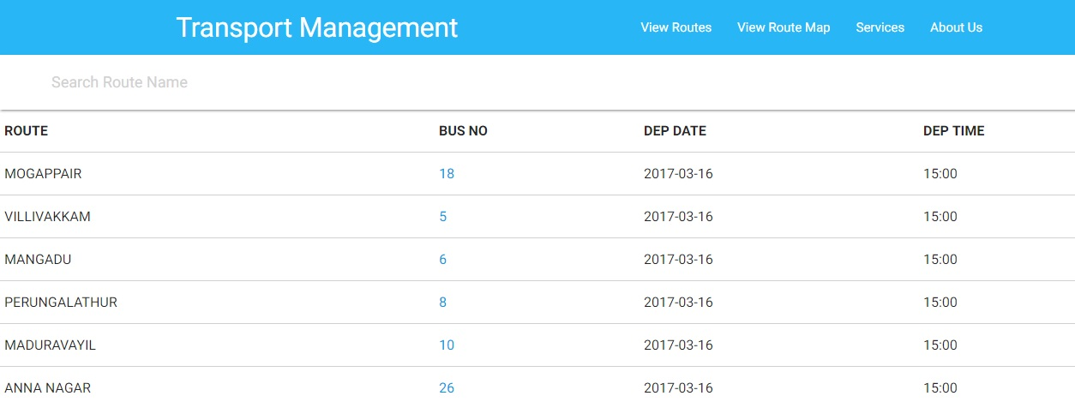
SCREENSHORT 4
View routes for the particular day for the students:

Slide 17
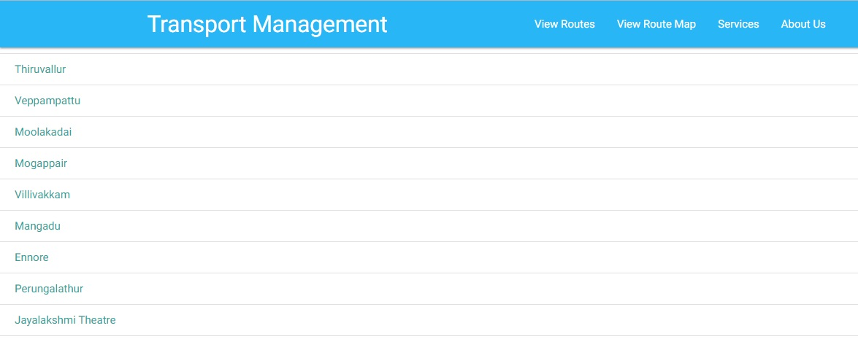
SCREENSHORT 5
Google Map for every route is displayed onClick :

Slide 18
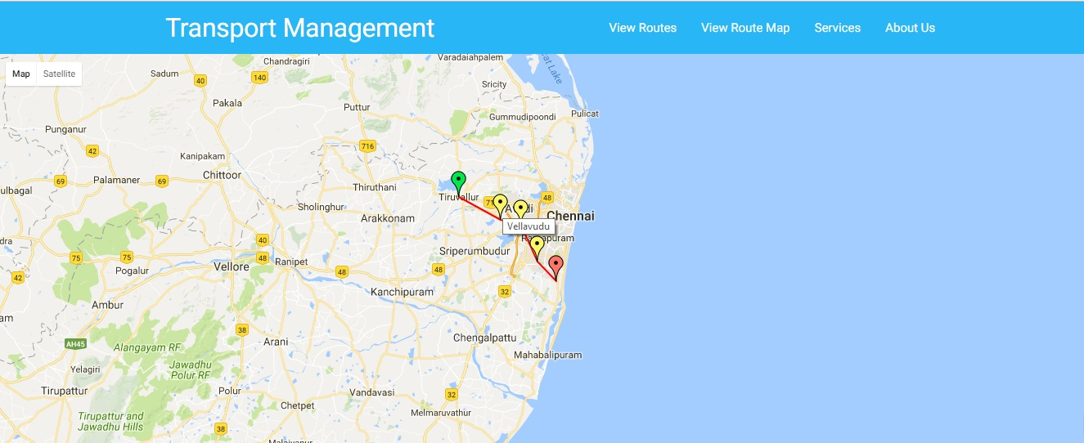
SCREENSHORT 6
Google Map for a particular route is displayed :

Slide 19


REFERENCES
TRANSPORT DEPARTMENT ( JEPPIAAR ENGINEERING COLLEGE ).
Bus Management System based on Zigbee and GSM/GPRS" by L.V.Zhian , Hu-Han.
Spring Boot Documentation , https://docs.spring.io/spring-boot/docs/current-SNAPSHOT/reference/htmlsingle/
Spring Web MVC Documentation , https://docs.spring.io/spring/docs/current/spring-framework reference/html/mvc.html
MySql Server 5.7 Reference Docs , https://dev.mysql.com/doc/refman/5.7/en/
GITHUB Version Control

Slide 20
THANK YOU

